Slide 1
Privatech
Shikhar Kwatra (Data and AI Architect)
Rosanna Mannan (Attorney)
Dulce Ponceleon (Technology Researcher)
Paul Starrett (Data Scientist)
Empowering individuals to exercise their privacy rights!
Notes:
We designed this template so that each member of the project team has a set of slides with its own theme. Members, here’s how you add a new slide to just your set:
Mark where you want to add the slide: Select an existing one in the Thumbnails pane, click the New Slide button, then choose a layout. The new slide gets the same theme as the other slides in your set.
Careful! Don’t annoy your fellow presenters by accidentally changing their themes. That can happen if you choose a different theme from the Design tab, which changes all of the slides in the presentation to that look.

Slide 2
Agenda
Background, The Opportunity, and Our Approach
B2B and B2C Solution and Value Proposition
Business Model, Go-to-Market Strategy, Market Size, and Competitors
Potential Issues and Legal Requirements
Conclusion

Slide 3
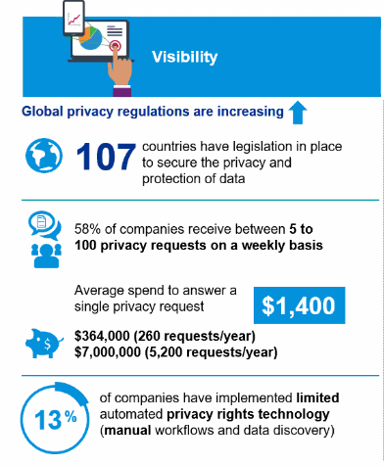
Background
New and increasingly stricter local and national laws, such as GDPR, CCPA, and LGPD, are providing citizens and consumers with data access, modification and deletion rights.
These laws give individuals the choice to consent to cookies and to the selling of their personal information.
These laws also allow individuals to submit privacy requests.
Companies collect, process, and manage personal information, but individuals do not have a way to manage their new privacy rights.

Slide 4
Background - CCPA
When the California Consumer Privacy Act 2018 (“CCPA”) went into effect on January 1, 2020, it brought with it the potential for a wave of class action lawsuits from California consumers whose personal identifiable information is compromised in data breaches.
Salesforce, Zoom, Marriott, Ambry Genetics, Tik Tok, and many others are being sued for illegally sharing personal identifiable information of their users as well as for data breaches.
Hackers can “scrape” customers’ names, addresses, and credit card information from a company’s website and put it up for sale on the dark web.

Slide 5
The Opportunity
The global data governance market size is expected to grow from USD $2 billion in 2020 to USD $5.7 billion in 2025, at compound annual growth rate (CAGR) of 22.3% during the forecast period.
The data privacy market is growing exponentially and people want more control over their data.
See https://www.marketsandmarkets.com/Market-Reports/data-governance-market-108243043.html
Many companies focus on detecting if your personal information has been exposed by a data breach. These methods are reactive in nature, because they occur after the personal information is exposed.

Slide 6
Our Approach
There is an untapped market opportunity for proactively detecting at the right time what users are consenting to and signing up for, while they navigate through different websites and online applications.
We propose a privacy enhancing technology (PET) that proactively
Empowers individuals exercise their privacy rights
Manages cookie consent
Handles access and deletion requests
Tracks the companies that have the user’s data
Monitors children’s privacy

Slide 7
Our Approach
Privatech is a privacy management provider for end-consumers to provide users with proactive notifications and remediation strategies to enhance the user’s understanding of what they are signing up for and to allow them to have enhanced control over their data privacy rights.

Slide 8
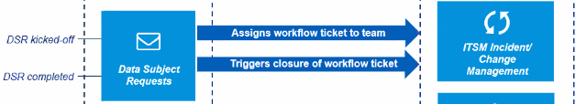
B2C Solution
Managing Privacy Preferences and Informing of Policies
Making Access and Deletion Requests
The application crawls over website and notifies the user of cookies and the terms and conditions of the website.
A notification pops up in the browser with default ”no” and lists items which the user is currently subscribing to and advises them of what is in the privacy policy.
By scraping the privacy policy, Privatech will know who to contact to make a request to access or delete the user’s personal identifiable information and will make that request if the user chooses.

Slide 9
B2C Solution Continued
Tracking Information a User Provides to Companies
Managing Children’s Privacy
If the user subscribes to or pays for anything, Privatech will allow the user to choose to track the company who is getting their information.
Privatech will also allow the user to track what type of information was sent.
This information will be saved in a Vault on the user’s device.
The application will provide passive surveillance to monitor children’s privacy rights.
The application’s web crawler gathers data about what websites the child is visiting and informs of the parents if the child inputs their personal information.
The application blocks adult websites until the parent gives consent.

Slide 10
B2B Solution
Managing Enterprise Privacy For Employees
Managing Personal Information the Company Collects
The application can be used by companies to monitor the personal information employees are sharing online while they are working.
The application stores the personal information that a company collects in a secure encrypted Vault.
The B2B solution integrates with the B2C solution to receive privacy requests and respond to them.

Slide 11
Value Proposition
Why this Solution is Unique
There is no application out there that manages privacy rights optimally.
Privacy laws are new and continually changing and software needs to keep up with this change.
Gives individuals power and control over how their privacy is managed.

Slide 12
Business Model
A Fixed Business Model
Basic Content (information tracking and notification management) will be free for 1 month or completely free with ads
Premium Content (managing requests and unlimited proactive data privacy control) will cost $2.99/month, $24.99/year
Subscription Model with a Trial Period
The application can also have a trial period before the subscription cycle starts.
During the trial period, the user will reach a limit of 20 actions, and then the trial period will end and the user must subscribe

Slide 13
Go-to-Market Strategy
Go To Market Strategy
Customer Acquisition Cost
Publicized through social media portals
Facebook ads
Twitter ($750 per post)
Instagram ($1200 per post)
Youtube
LinkedIn
Tik Tok ($2500 per post)
Use Google analytics to keep track of traction and identifying any market gaps
Education awareness through personalized videos and cold-call influencer campaigns
Facebook advertising costs, on average, $0.97 per click and $7.19 per 1000 impressions.
The average Instagram ad CPC (cost-per-click) is around $0.50 – $1.00
Based on advertisement cost estimates, the average pre-revenue CAC can be estimated to be around $1.50 per customer.

Slide 14
Market Size
The global data governance market size is expected to grow from USD 2.1 billion in 2020 to USD 5.7 billion by 2025, at a Compound Annual Growth Rate (CAGR) of 22.3% during the forecast period.
The market size is potentially anyone in the world who will use this application to manage their privacy rights.

Slide 15
Competitors
Similar Applications
LastPass manages and saves passwords individuals input to online forms
Honey is an online coupon manager that uses a web crawler to manage online coupons
Another company has used web crawlers to identify information from the Terms and Conditions of a website, then extracts relevant critical information from there to showcase to the user

Slide 16
Potential Issues
Companies won’t honor requests because it is cost-intensive and requires manual effort to respond
People will not care about their privacy rights and will not want to manage their privacy rights for a fee
If offered for free, how can you make business?
Will the startup sell or not sell the collected data?
Server farms are expensive
Need to get investment, insurance, etc.

Slide 17
Legal Requirements
Add disclaimer about warranty and limitation of liability that the AI code may not be 100% accurate
Use promissory notes and SAFE for early funding; create 10 million shares at first (2.5 million per founders, and 2.5 for the option plan) (4 year vesting with 1 year clip)
Set up as a Delaware corporation and issue stocks (Cost = $20,000-$30,000) (Clerky)
Create an incident response plan for a data breach.
File for Intellectual Property
Patent will cost $10-$15k
Trademark for one class will cost $400
B2C Direct Sale: We will negotiate an End User License Agreement (EULA) with the user or include a click through EULA with a copy of the software.
B2B Sale: We will negotiate a Hosted Services Agreement with the company.

Slide 18
Conclusion
The application will empower users to exercise their privacy rights and is the first of its kind.
We envision enabling this as a plugin software for users across the globe to manage their data being shared in a more transparent fashion and to have enhanced control over their data.

Slide 19
Thank You!

